Slide 1


Join at slido.com #3436682
ⓘ Start presenting to display the joining instructions on this slide.

Slide 2
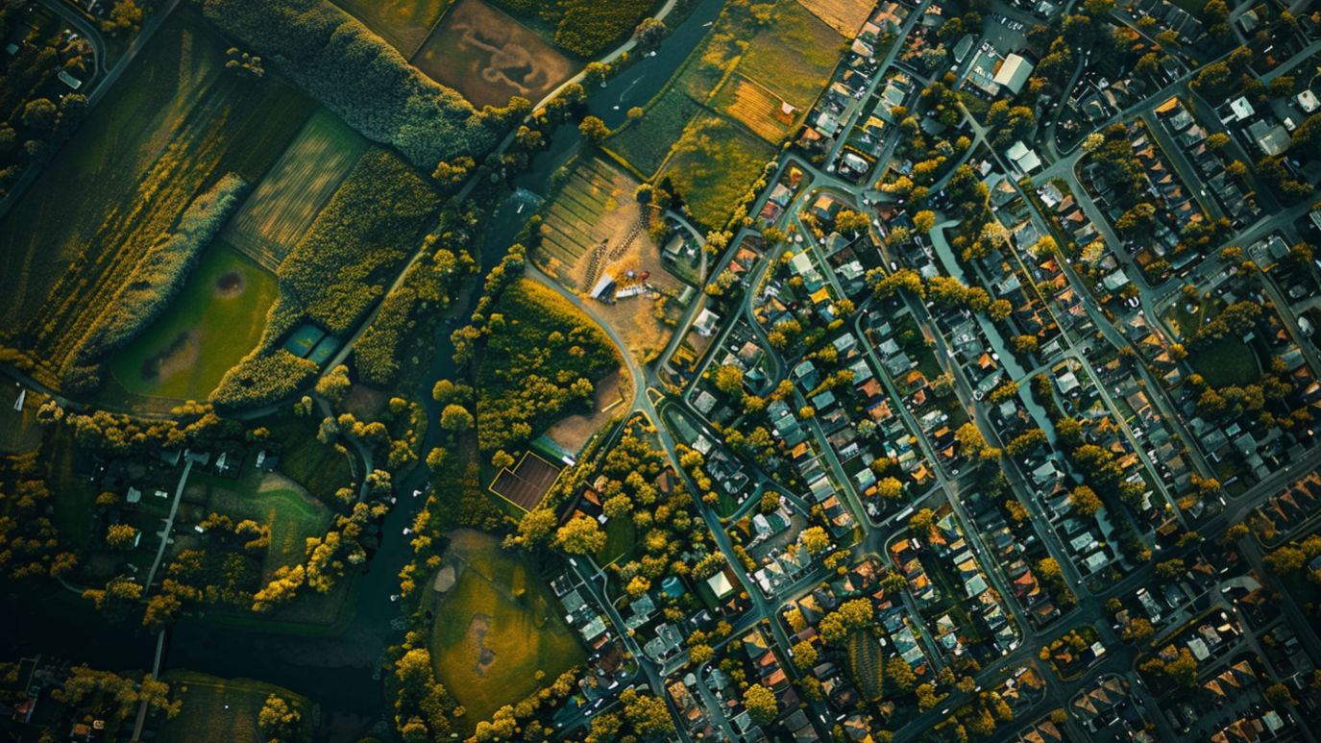
Clearing the Air: Unveiling Insights on Health Through Data Analysis

Slide 3
THE Process
Data and PRocess

Slide 4
OpenWeatherMap Air Pollution API
Global Health Data Exchange
Australian Bureau of Statistics (2021) Regional Population
API NINJAS
Study Objective:
Analyse key air pollution metrics at varying scales and over different timeframes to evaluate impact on public health and wellbeing.
Collation
Cleaning
2
Data Preparation
Descriptive Stats
1
Define
3
Exploratory Data Analysis
Graphical Stats
Input: Hypothesis
6
Review &
Feedback
4
Interpretation & Validation
5
Conclusions
Output: Reporting

Slide 5
LET’s HAVE SOME FUN
HYPOTHESES Q&A

Slide 6

The greater the population size, the higher the recorded pollution in a town or city.
ⓘ Start presenting to display the poll results on this slide.
Notes:
Alvin

Slide 7
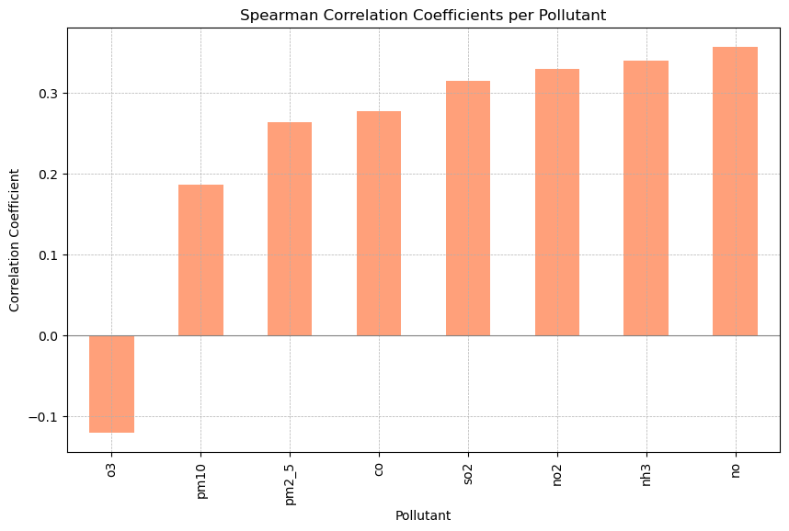
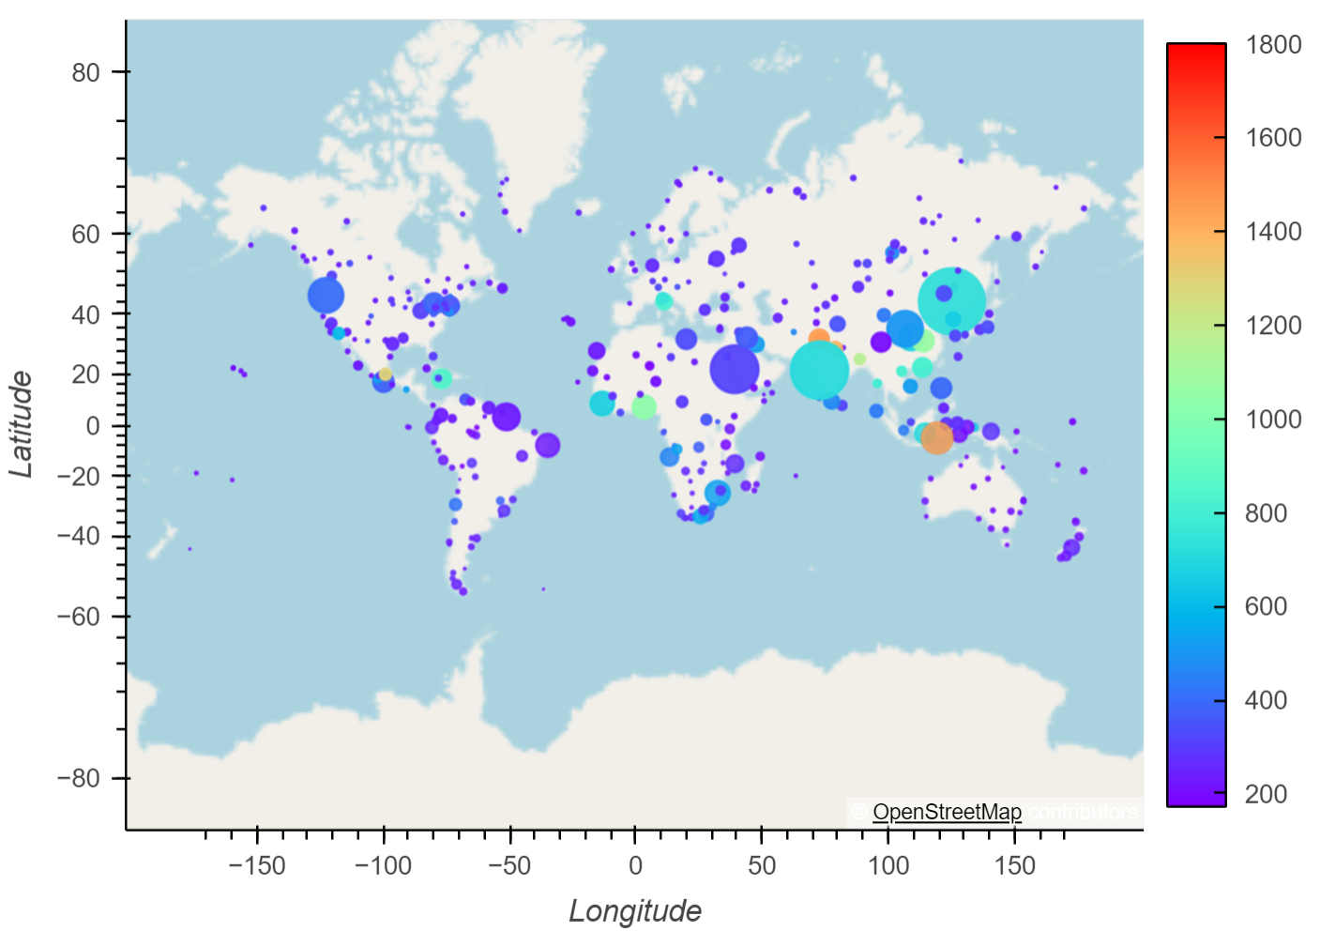
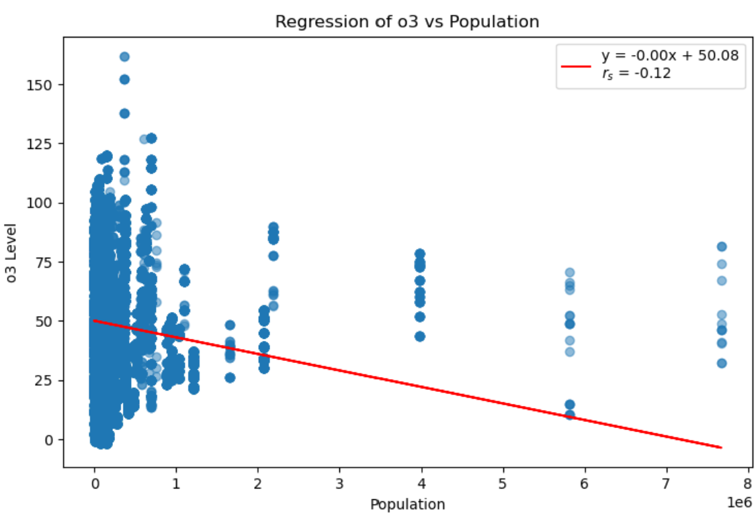
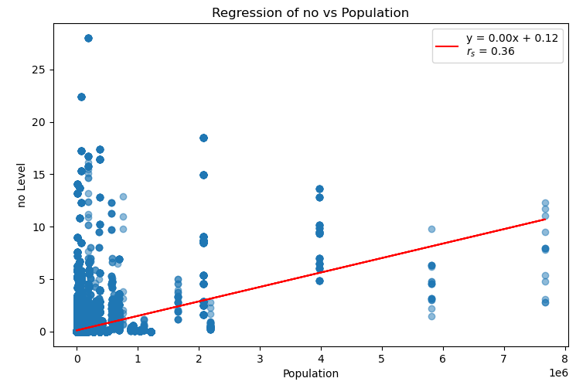
Global Winter CO Pollution Levels in μg/m by Population
*population size = bubble size
Notes:
Alvin

Slide 8
Higher population densities are associated with higher air pollution levels in Australian towns and cities.
ⓘ Start presenting to display the poll results on this slide.

Slide 9
Notes:
Alvin

Slide 10
Pollutant levels vary significantly across the four season.
ⓘ Start presenting to display the poll results on this slide.

Slide 11
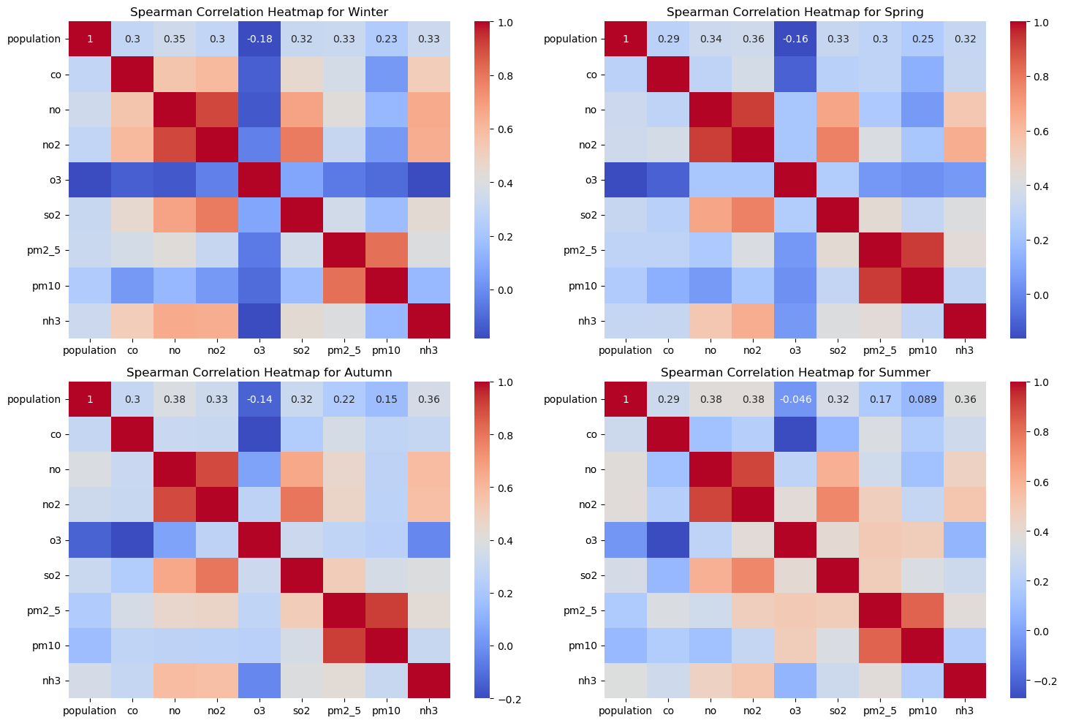
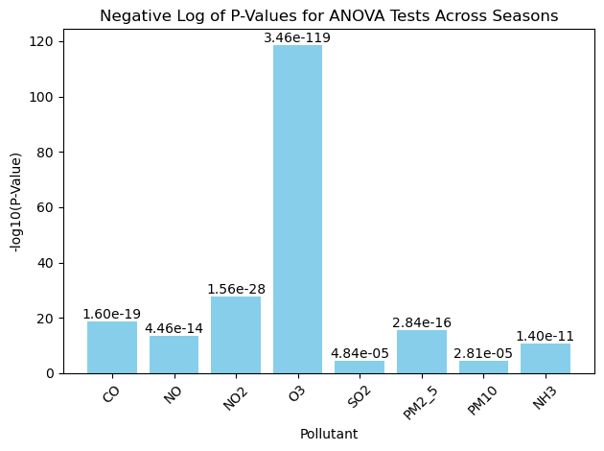
Winter
Spring
Autumn
Summer
Notes:
Population and Pollution: Higher population densities tend to increase levels of nitrogen oxides and particulate matter.
Ozone Behavior: Ozone levels often decrease when other pollutants increase, indicating complex chemical interactions.
Seasonal Impact: The relationship between population and pollutants varies slightly with the seasons, showing how weather and activities influence air quality.

Slide 12
Higher levels of air pollutants correlate with higher occurrences of depressive disorders.
ⓘ Start presenting to display the poll results on this slide.

Slide 14
There are higher occurrences of respiratory disorders in towns and cities with higher levels of pollution.
ⓘ Start presenting to display the poll results on this slide.

Slide 16
CONCLUSIONS
SO WHAT ARE OUR THOUGHTS

Slide 18

THANK YOU

